Slide 1


Slide 2


Slide 3

Introduction to Pandas
Definition
Pandas is an open-source data manipulation and analysis library for Python
Key Features
High-level data structures and methods
Handles missing data gracefully
Easy handling of data from various sources

Slide 4

Why Use Pandas?
Advantages
Easy data manipulation
Integration with other libraries (NumPy, Matplotlib, etc.)
Powerful data cleaning capabilities
Use Cases
Data analysis
Data visualization
Data preprocessing for machine learning

Slide 5

Installing Pandas
Command
pip install pandas

Slide 6

Importing Pandas
Code Example
Explanation
‘pd’ is a common alias used for Pandas

Slide 7


Data Structures in Pandas
Series
1-dimensional labeled array
Example
pd.Series([1, 2, 3])
DataFrame
2-dimensional labeled data structure
Example
pd.DataFrame({'column1': [1, 2], 'column2': [3, 4]})

Slide 8
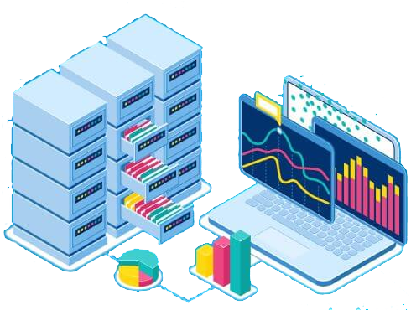
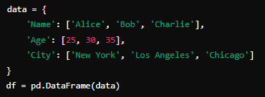

Creating a DataFrame
Code Example
Explanation
Creating a DataFrame from a dictionary

Slide 9
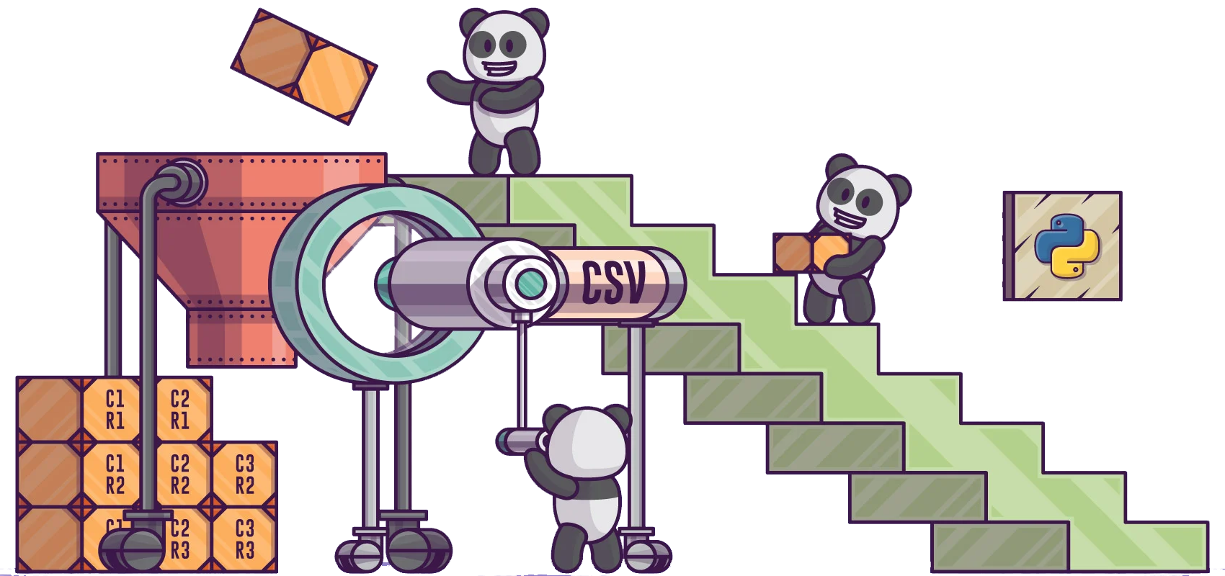
Reading Data from Files
CSV File
Code Example
df = pd.read_csv('data.csv')
Excel File
Code Example
df = pd.read_excel('data.xlsx')

Slide 10

Basic DataFrame Operations
Head and Tail
df.head()
Displays the first 5 rows
df.tail()
Displays the last 5 rows
Shape and Columns
df.shape
Returns the shape of the DataFrame
df.columns
Returns the column names

Slide 11


Accessing Data
Loc and Iloc
df.loc[row_label]
Access rows by labels
df.iloc[row_index]
Access rows by index
Code Example

Slide 12


Data Manipulation
Filtering Data
df[df['Age'] > 30]
Filter rows where age is greater than 30
Sorting Data
df.sort_values(by='Age')
Sort DataFrame by age
Code Example

Slide 13
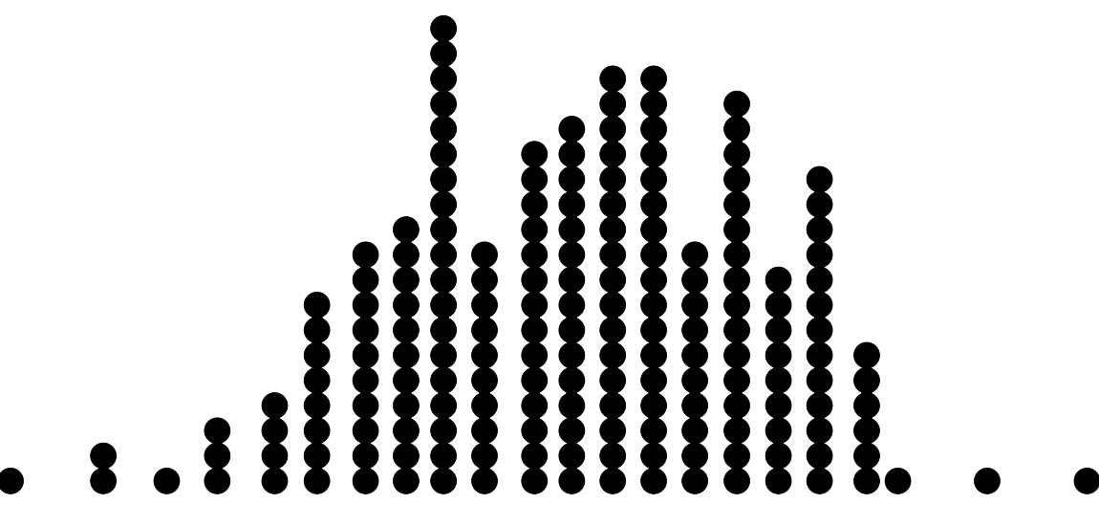

Grouping and Aggregation
Group By
df.groupby('City').mean()
Group by city and calculate the mean
Aggregation
df['Age'].sum()
Sum of ages
Code Example

Slide 14

What is Pandas primarily used for?
Data manipulation and analysis
Which command is used to install Pandas using pip?
pip install pandas
What does pd typically represent when importing Pandas?
A Pandas module
Which Pandas data structure is best suited for storing 2-dimensional labeled data?
DataFrame

Slide 15

Practice lectures steps

